Slide 2
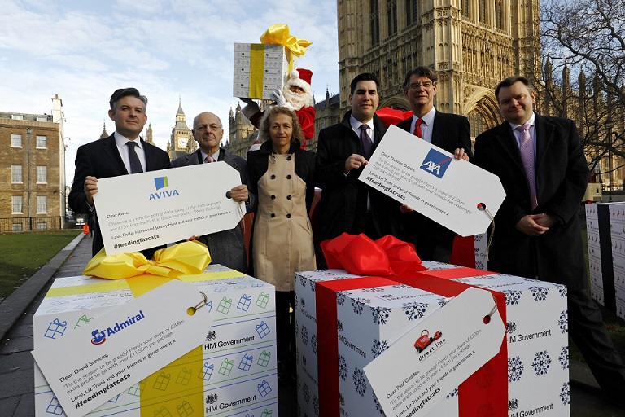
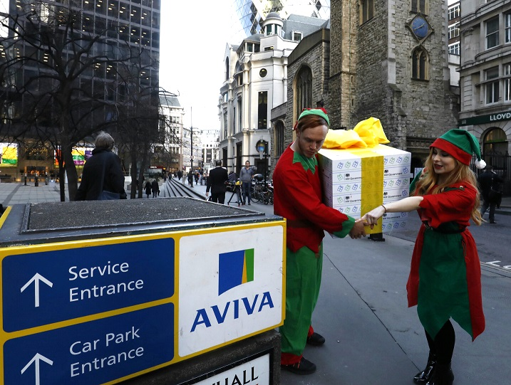
The government is attacking working people
Government proposals will affect 1 million people every year, taking away free or affordable independent legal advice from 95% of injured people including those injured at work.

Slide 3
The government has ‘consulted’ on its plans
What does the consultation paper Impact Assessment reveal?
The changes will:
Cost the Treasury £135m EVERY YEAR
Cost the NHS £9-13m EVERY YEAR
Gift at least an additional £200m in profit to the insurers EVERY YEAR

Slide 4
Insurance company profits and the pay of their CEOs are soaring
Motor insurers saved over £8bn on claims costs in the last 5 years
Direct Line and Admiral paid out £2.856bn in shareholder dividends in the last three years - that’s £350 for every policyholder
The CEOs of the insurers are on eye-watering £multi-million salaries – Direct Line’s Paul Geddes is on £4.82m and Aviva’s Mark Wilson gets £5.67m
AND YET PREMIUMS KEEP RISING

Slide 5
What the government is planning
The government has announced plans to raise the small claims limit in all personal injury claims, including work accidents, from £1,000 to £5,000.
This will mean anyone injured anywhere, at work or on the road, who wants independent legal advice will have to pay for it out of money meant for their losses and injuries. Or they will have to take on insurers – who will still use lawyers and wily negotiators - on their own in their own time.
The change would result in the removal of free legal advice from nearly a million injured people every year to line the pockets of multinational insurance companies.

Slide 6
How this will affect your members
These plans are an attack on the ability of working people to access justice
These changes threaten the ability of anyone injured anywhere to make a claim at all
It gives a green light to employers to ignore health and safety at work
Reduce income from court fees
Insurance companies won’t be paying the NHS back for the treatment needed by injured people
Threat to the ability of trade unions to provide free legal services to their members including employment cases because the service is based on negligent employers paying the legal costs of the PI cases members win against them.

Slide 7
What crisis? It’s a Con
The government and the insurers say there is a fraud crisis in motor claims.
The power is with the insurers: if they don’t think a claim is genuine, don’t pay out. Reject it. Report it.
Insurers paid out in 99% of all claims last year so rather than sort out their own systems, insurers are hitting all injury victims.
Whiplash is being used as a fig leaf to attack people injured anywhere including at work.
There are no complaints of fraud being a problem in work accident claims.
The total number of injury cases has dropped by 6% since 2013.

Slide 8
What is the real target and why?
The real target is not whiplash.
This is about taking away funding for all injured people to get independent legal representation.
This helps the insurance industry who are mates with the Conservatives.
So much for the PM saying ‘when we pass new laws we will listen not to the mighty but to you’.
These changes will only help the ‘privileged few’.

Slide 9
What does an increase in the small claims limit actually mean?
For now, if you are injured due to someone else’s fault, you are entitled to claim compensation for the pain and suffering and for any financial losses
Currently, if you are injured and the value of your compensation for the pain and suffering is worth more than £1000 you are entitled to recover your legal fees from the other side.
If the small claims limit is raised to £5000 and you have, a back injury that takes 1-2 years to recover from (worth less than £5,000) you won’t get your legal fees paid for to fight your case.
Tens of thousands of injured people would be left having to pay legal fees
Or more likely they would not make a claim in the first place

Slide 10
The Tory story
The chancellor said that motorists would save £40 per policy, but there is no evidence to back this up.
The government’s own press release said that motorists ‘could see’ savings of ‘about’ £40.
The government is on record in January 2016 saying that they won’t force the insurance industry to pass on any savings to motorists.
The reality is that forcing up the small claims limit will line the pockets of Tory friends in the insurance industry and hit all injured people, including those injured at work and on the road.

Slide 11
Who has opposed the changes
The Transport Select Committee
Scotland’s laws
Lord Justice Jackson

Slide 12
#FeedingFatCats
Thompsons has launched a campaign against the proposed increase in the small claims limit.
We are working with the unions and we need your help.

Slide 13
Join the fight
Write to your local MP, urging them to oppose the changes
Sign the online petition at petition.parliament.uk/petitions/173099
Follow @FeedingFatCats on Twitter
Find out more at www.feedingfatcats.co.uk

